Slide 1


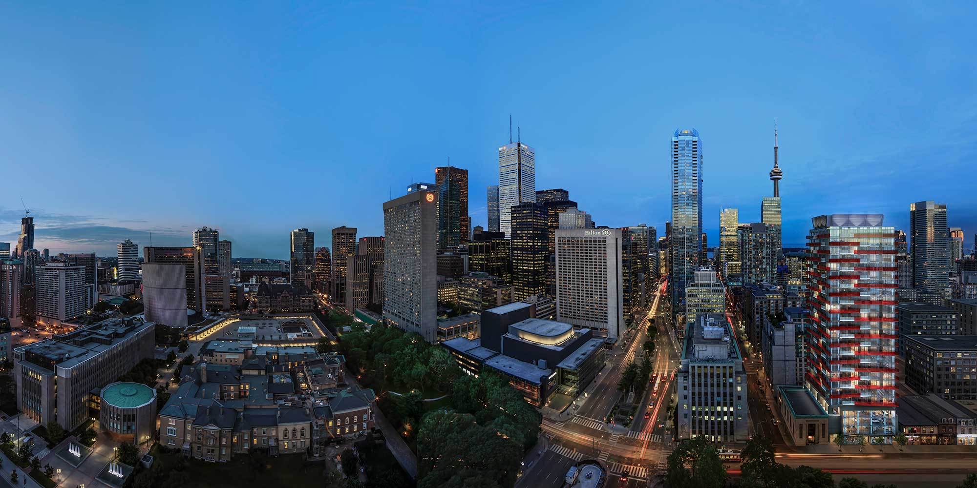

Slide 2
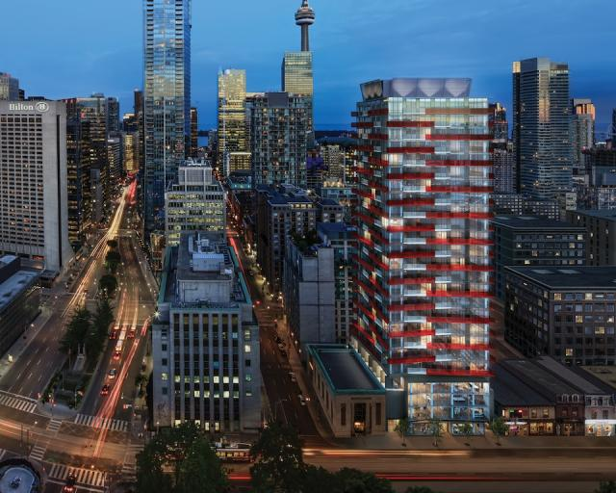


Slide 3
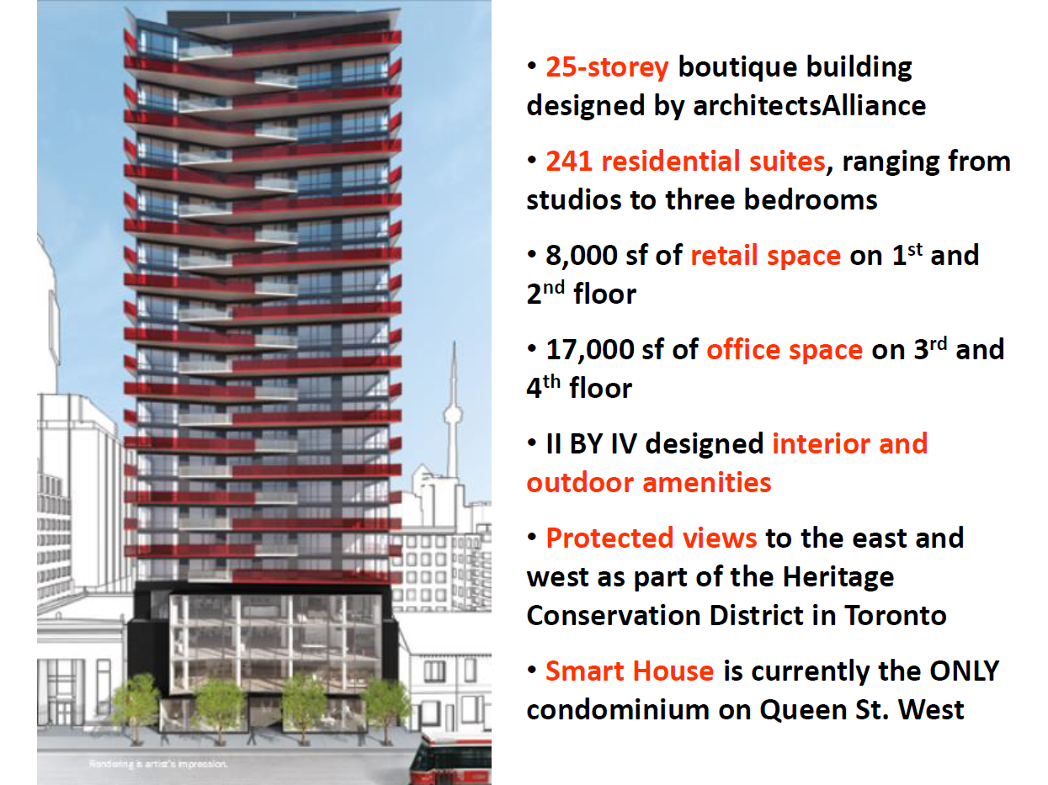

Slide 4
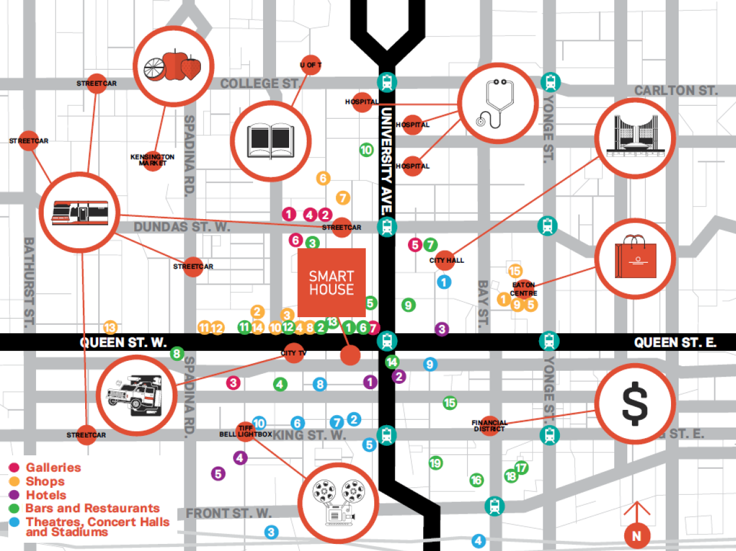

Slide 5
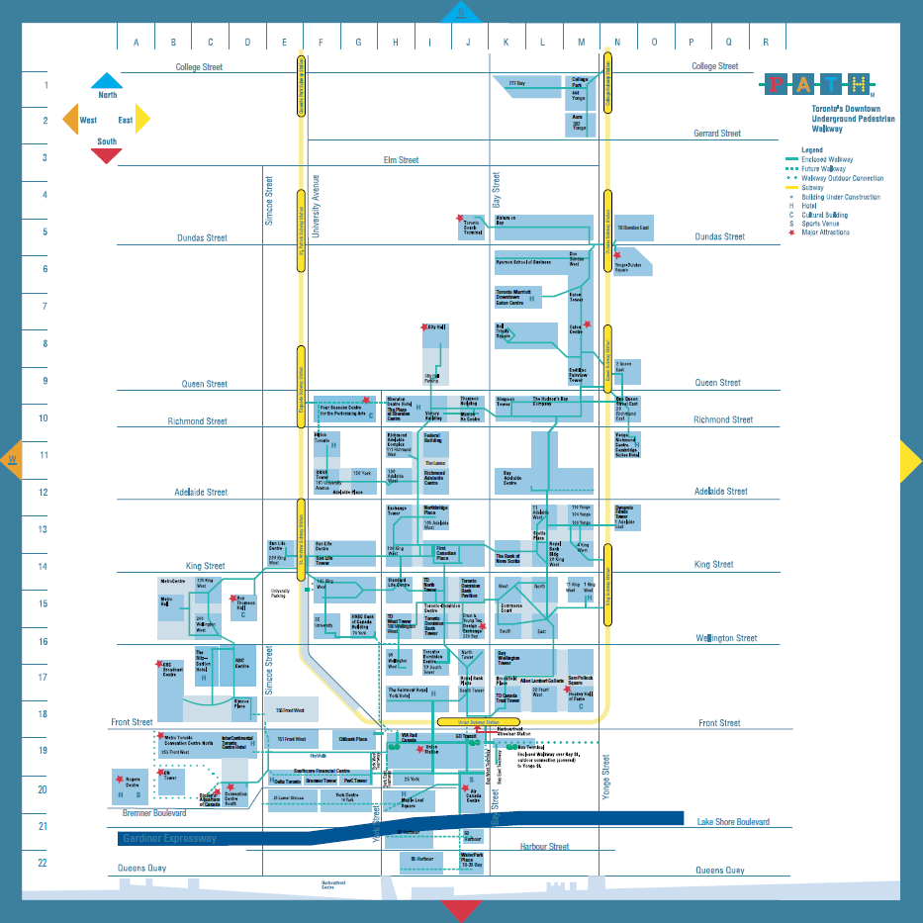

Slide 6
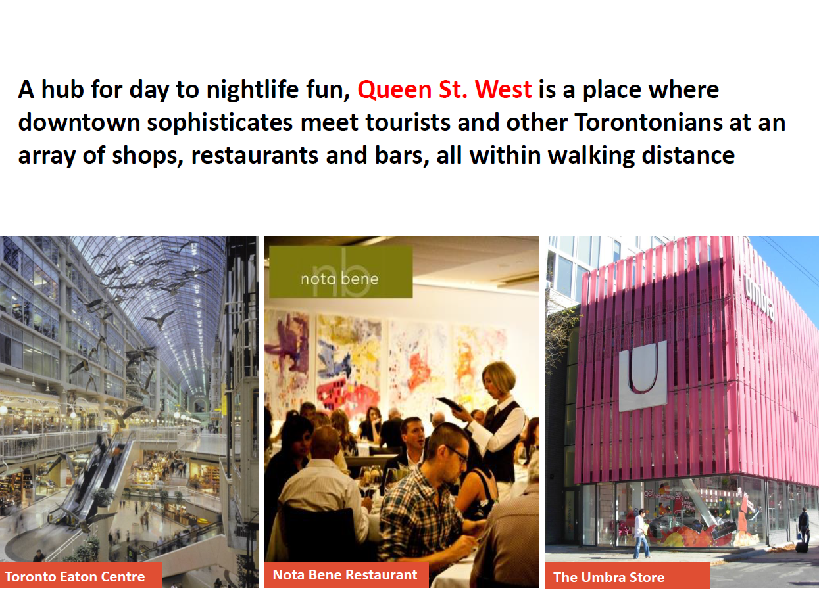

Slide 7
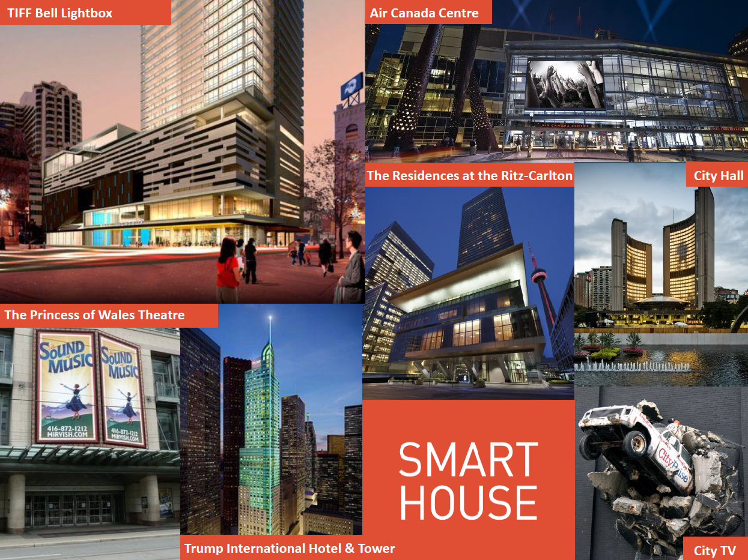

Slide 8
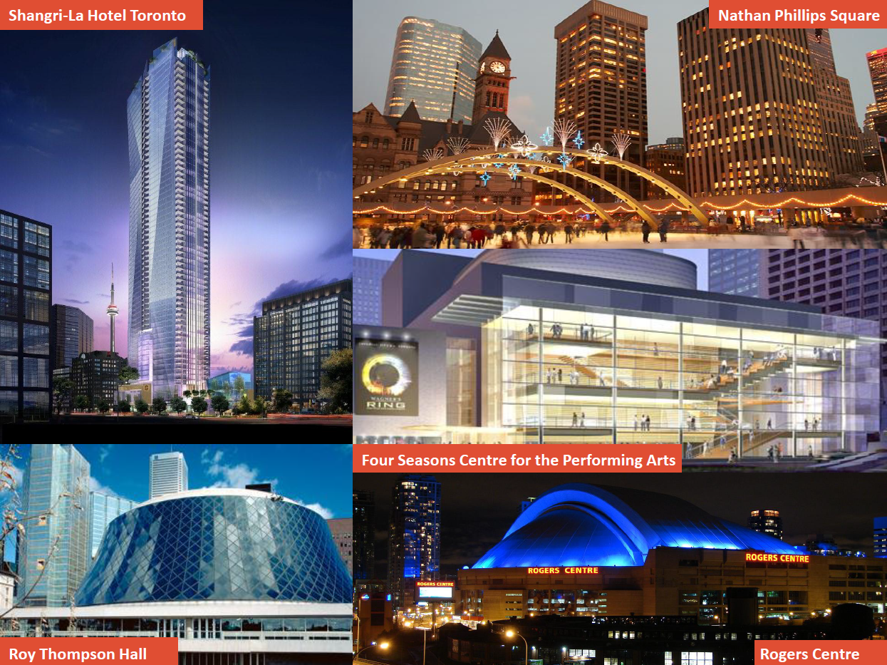

Slide 9
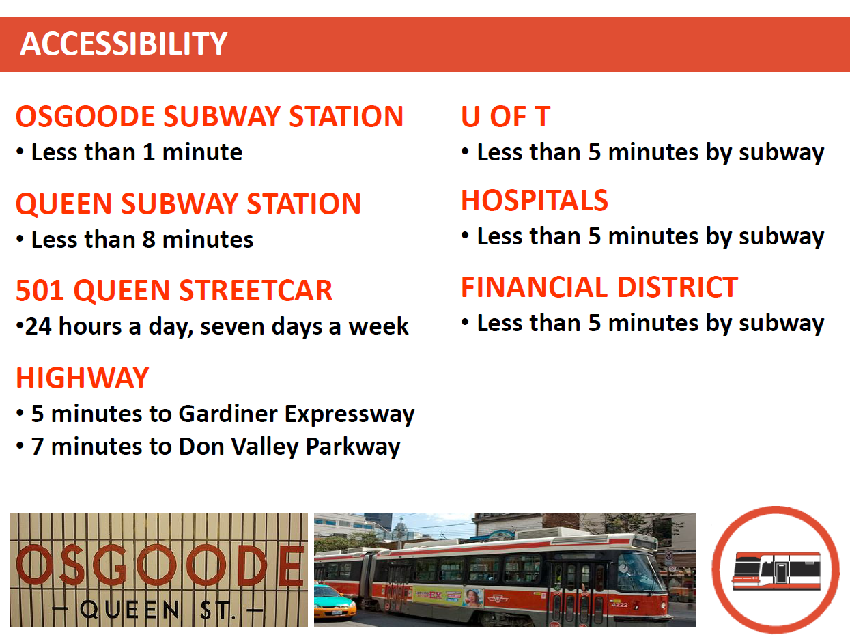

Slide 10
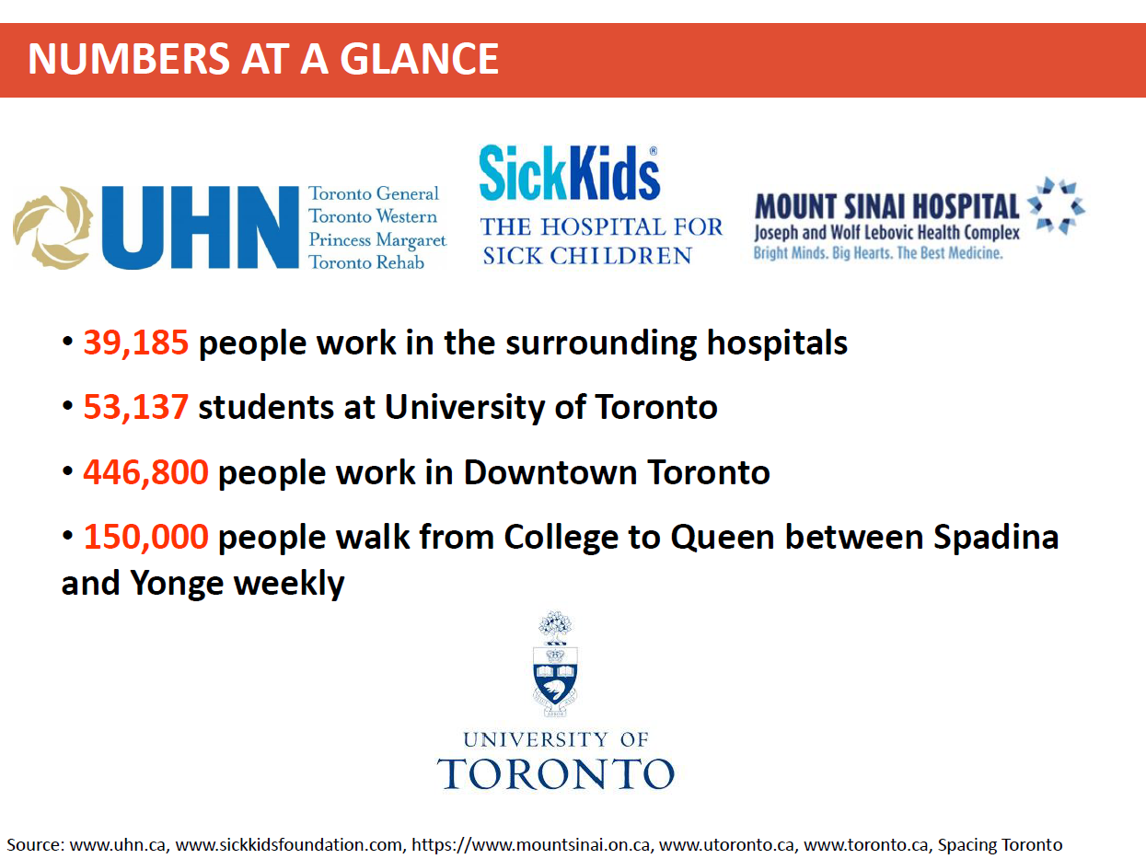

Slide 11
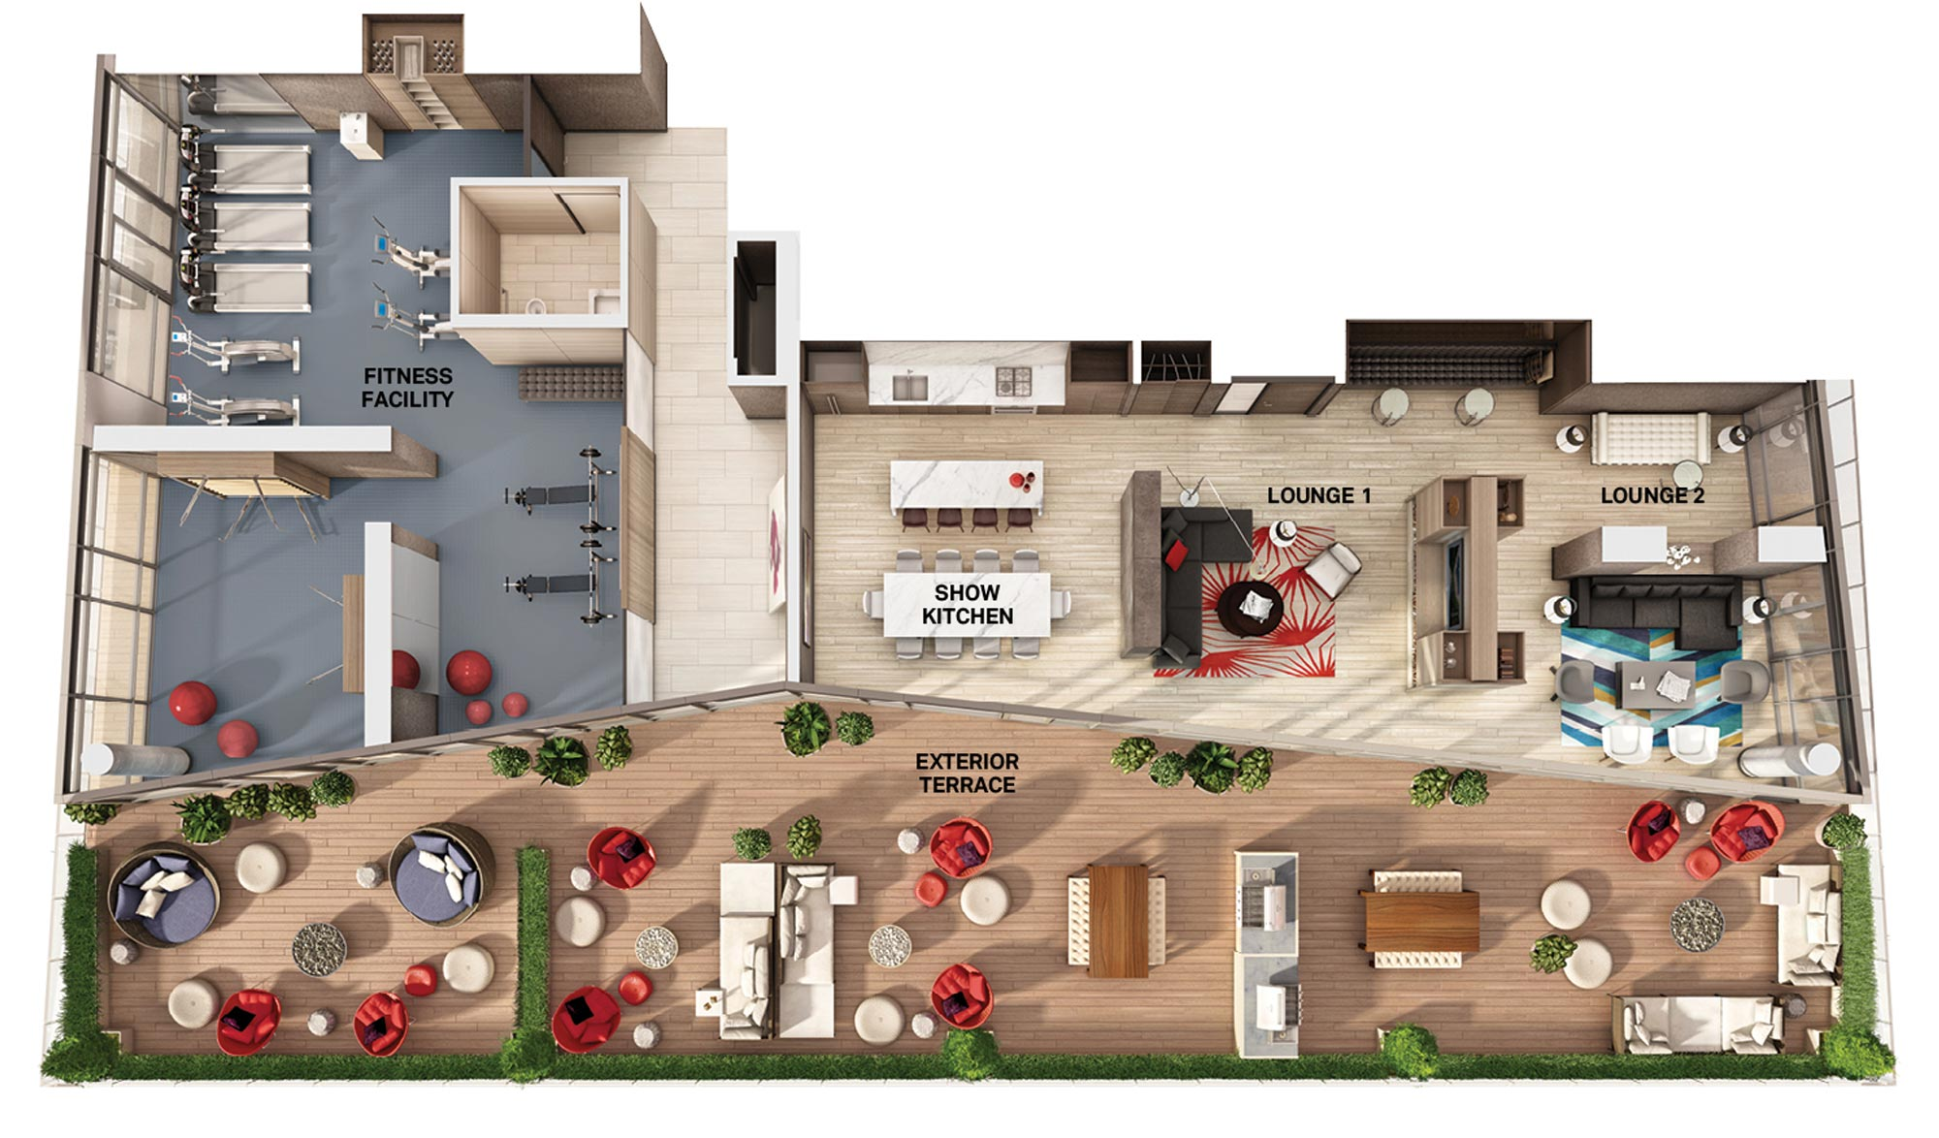

Slide 12
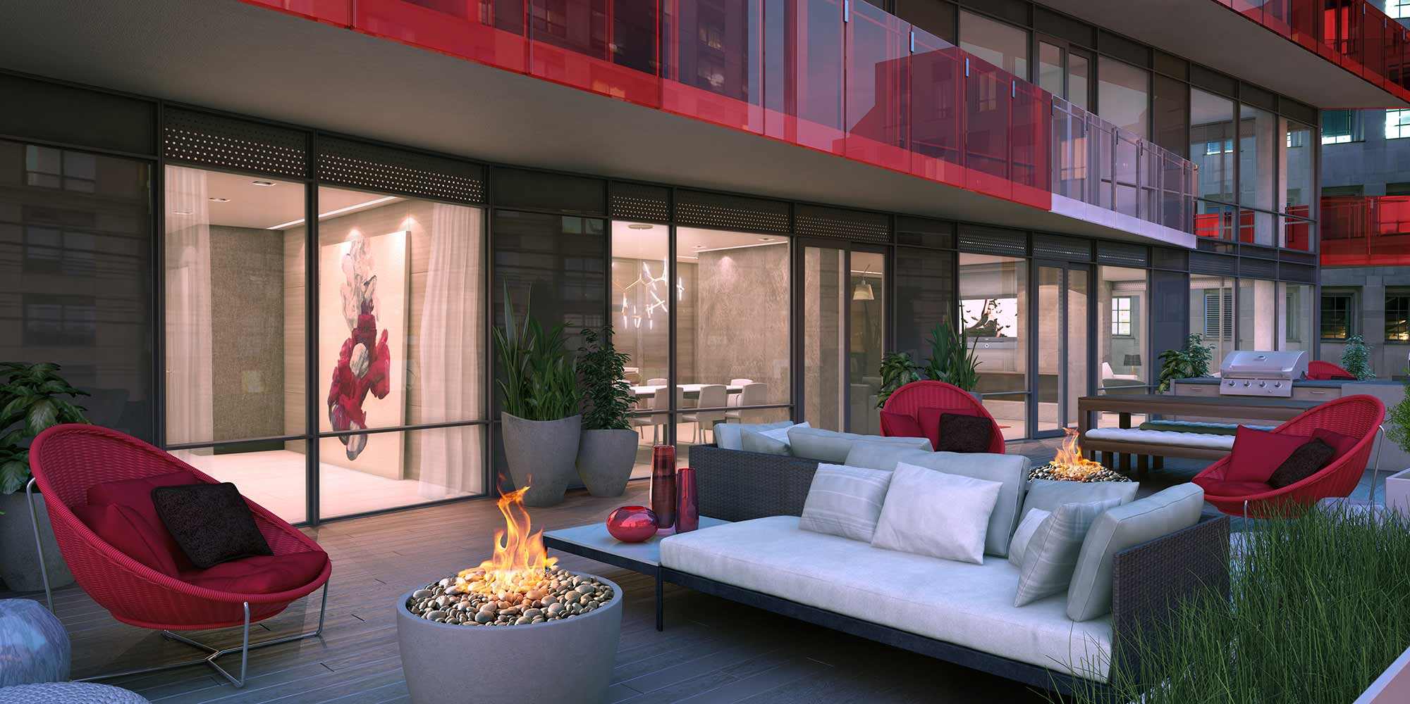

Slide 13
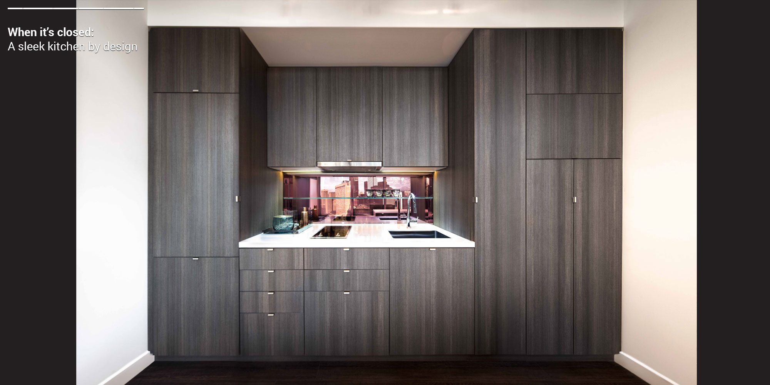

Slide 14
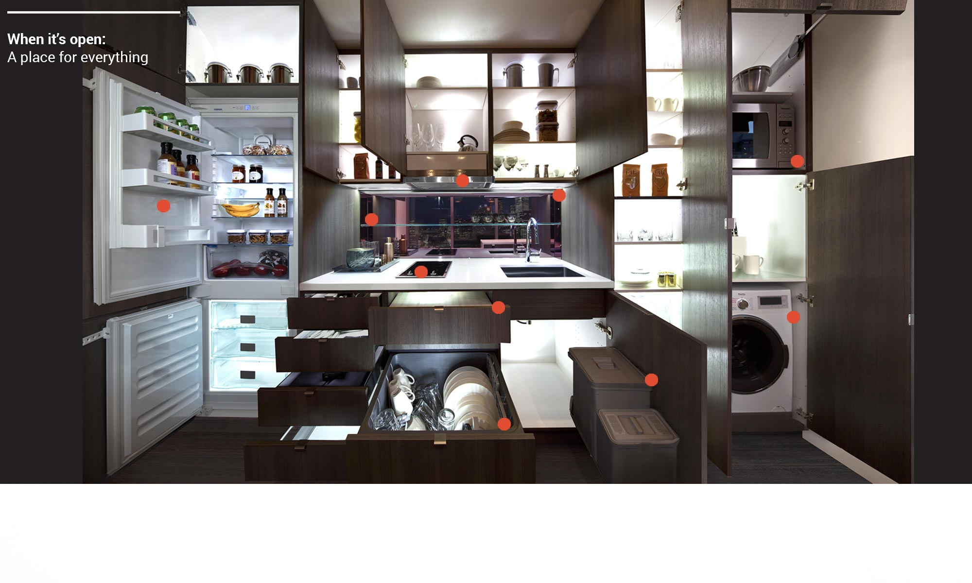

Slide 15
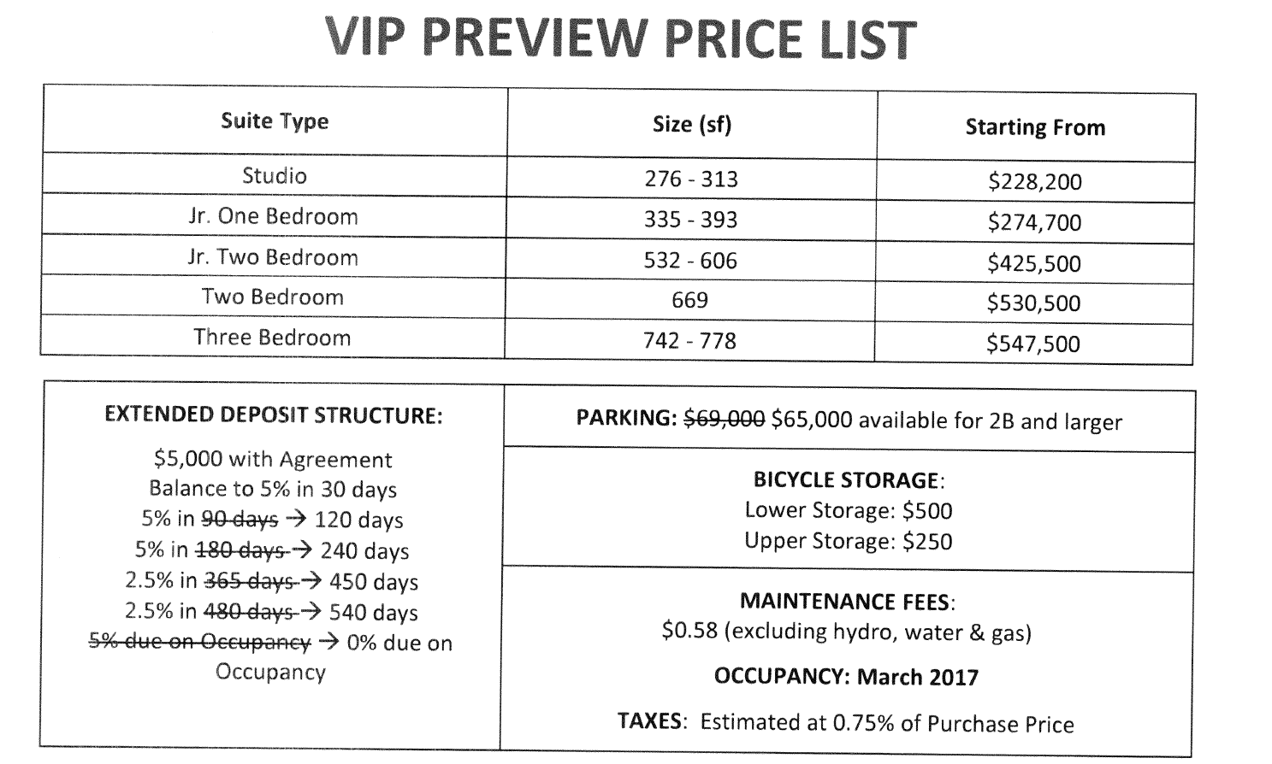

Slide 16
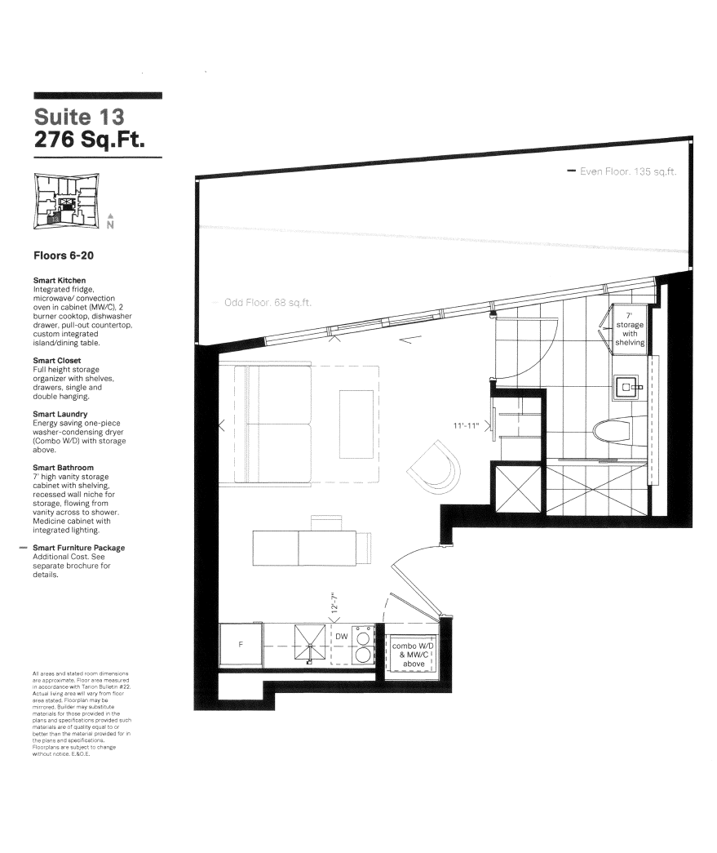
#1213
$236,200.00

Slide 17
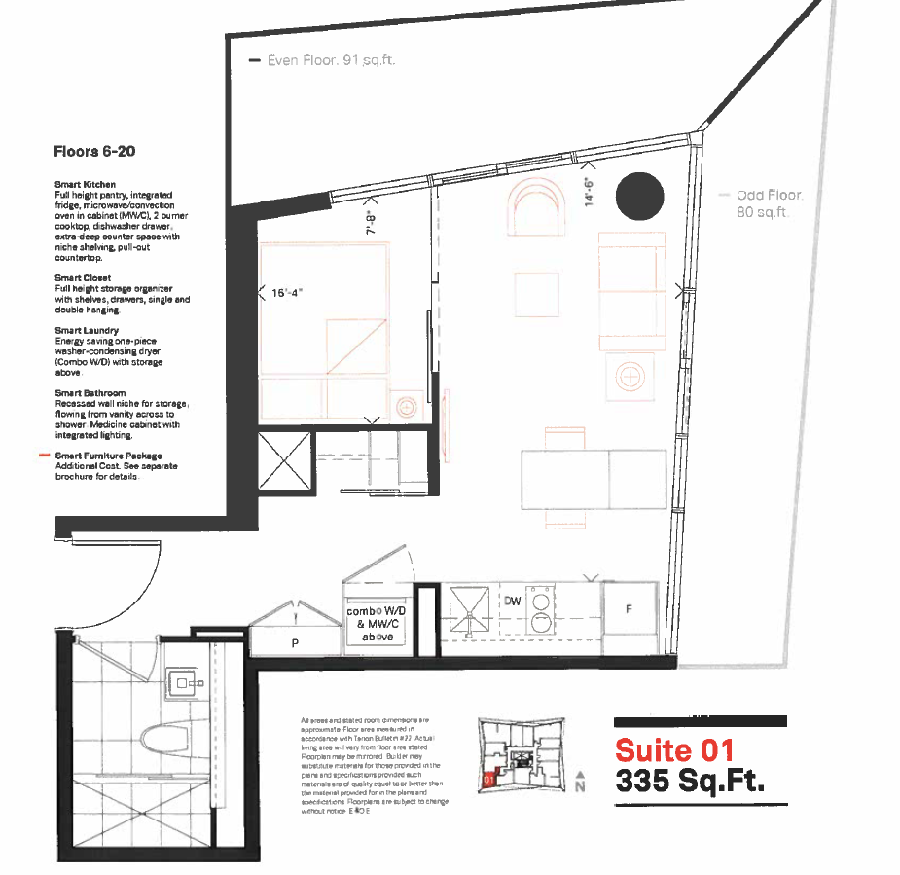
#1201
From 6/F to 20/F
$282,500.00

Slide 18
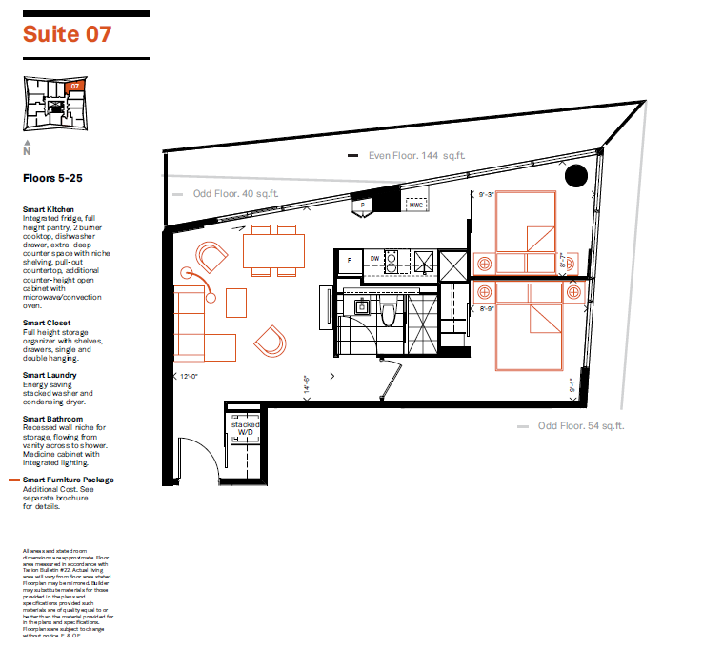
#1507
559 sq ft
Rent: $2,325.00
Cash back: $21,000.00
$443,500.00
Rent: $2,300.00

Slide 19
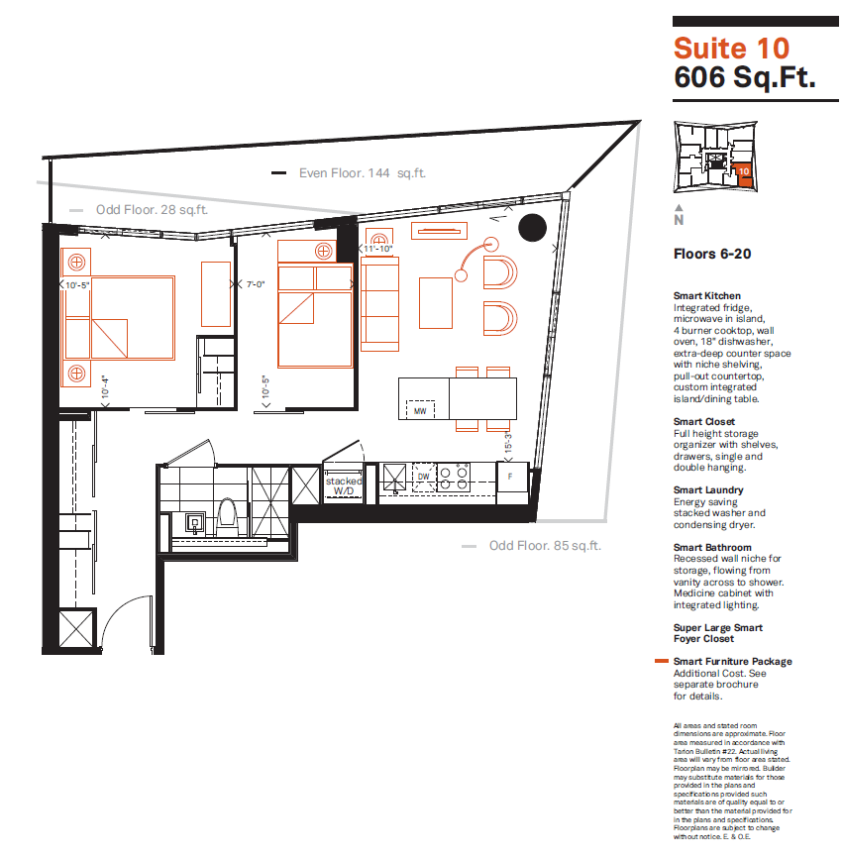
# 1510
Rent: $2,350.00
Cash back:
$21,000.00
$443,700.00
Rent: $2,300.00
Rent: $2,300.00

Slide 20
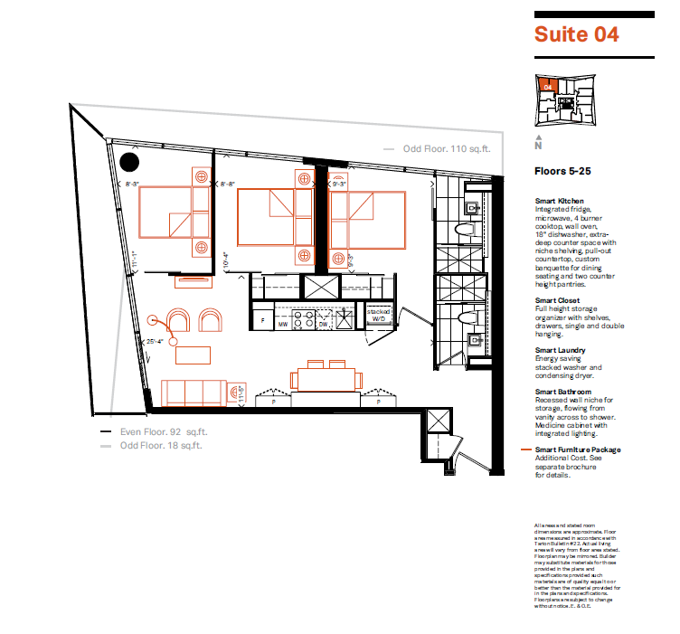
#1504
742 sq ft
Rent: $2,925.00
Cash Back:
$22,000.00
$547,500.00
Rent: $3,000.00

Slide 21
